Slide 1
Ice Sculpture per antea Meteorite
Dr. Daniel Jones and Dr. Michael Linnes

Slide 2
Intercultural openness
AAC&U Intercultural Knowledge and Competence VALUE Rubric
 | Developing | Emerging | Proficient
Attitude: Openness | Expresses openness to most, if not all, interactions with culturally different others. Has difficulty suspending any judgment in her/his interactions with culturally different others, and is aware of own judgment and expresses a willingness to change. | Begins to initiate and develop interactions with culturally different others. Begins to suspend judgment in valuing her/his interactions with culturally different others. | Initiates and develops interactions with culturally different others. Suspends judgment in valuing her/his interactions with culturally different others.

Slide 3
Ice Sculpture per antea meteorite
Dividing into 3 groups
Pittsburgh
Johnsonville
Lexington
With a large class, you’ll want to create sections that divide into 3 groups each.

Slide 4
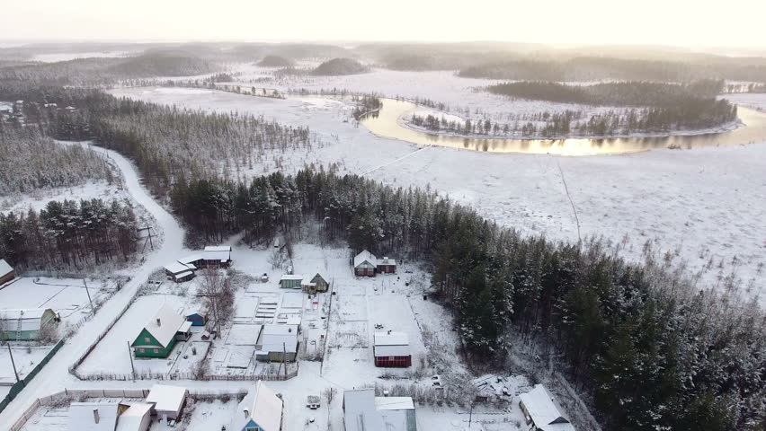
Ice Sculpture per antea meteorite
Story Introduction
It was the dead of winter…
Sculpture’s Location
Read over your group’s handout

Slide 5
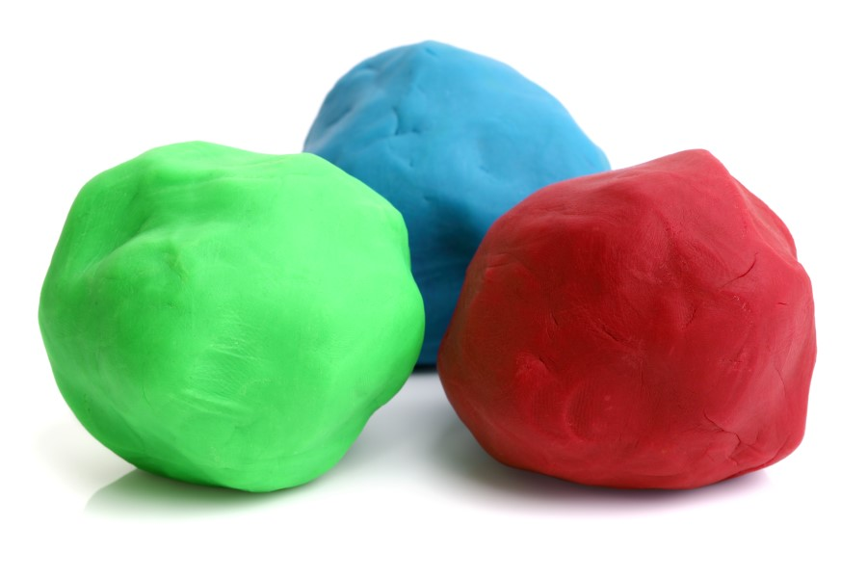
Ice Sculpture per antea meteorite
Form the sculpture out of clay
Form your best guess
Take a photo with your phone

Slide 6
Ice Sculpture per antea meteorite
Send representative to investigate
Johnsonville
Pittsburgh
Lexington

Slide 7
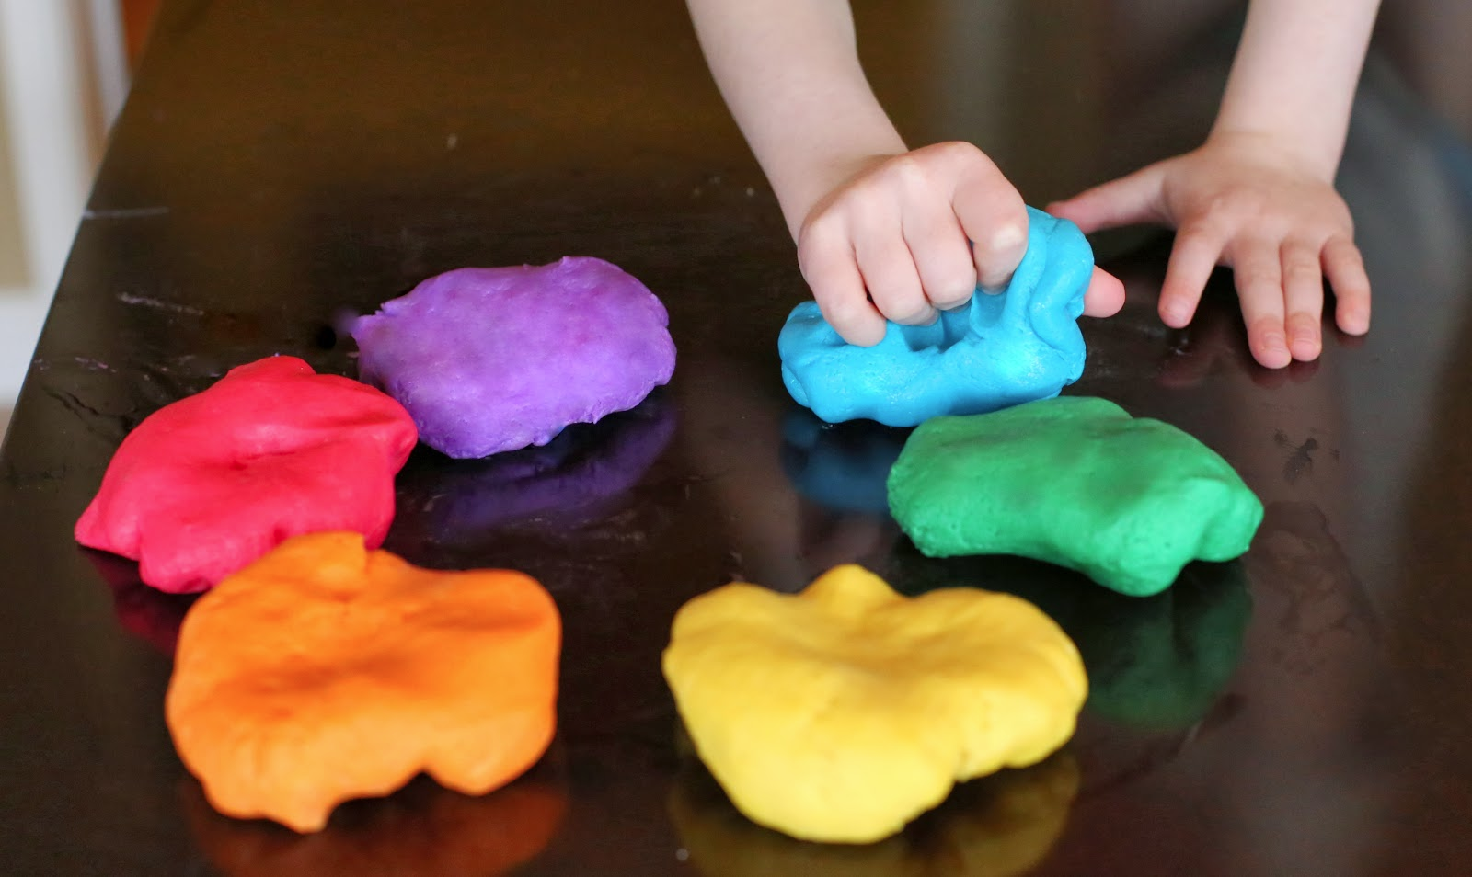
Ice Sculpture per antea meteorite
Form the sculpture out of clay
Incorporate the new information you’ve gained to form your best guess.
Take a photo with your phone.

Slide 8
Ice Sculpture per antea meteorite
Send representative to investigate
Johnsonville
Pittsburgh
Lexington

Slide 9
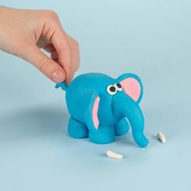
Ice Sculpture per antea meteorite
Form the sculpture out of clay
Incorporate the new information you’ve gained to form your best guess.

Slide 10
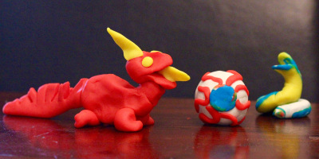
Ice Sculpture per antea meteorite
Presentation
Display your model sculpture.
Select a representative to present your solution to the rest of the group.

Slide 11
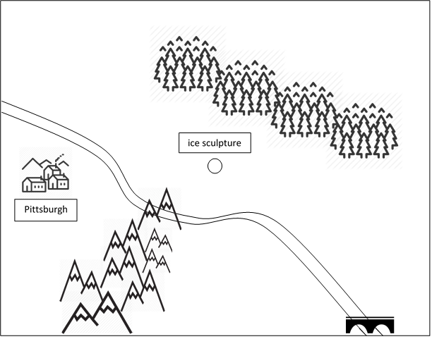
Ice Sculpture per antea meteorite
Perspective

Slide 12
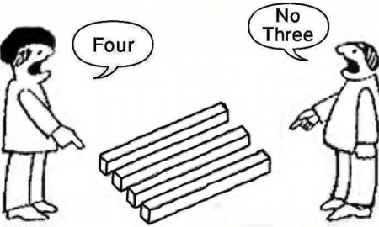
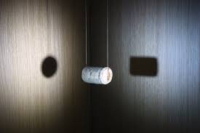
Ice Sculpture per antea meteorite
The Debrief
What happened in this activity?
What strategies did you use to solve the problem?
How did you feel during the activity?
What was the value of different perspectives?
What did you learn as a result of this activity? And why does this matter?
How does this relate to previous experiences you’ve had?

Slide 13
Ice Sculpture per antea meteorite
Key Insights and Learning
The knowledge of the individual sometimes isn’t enough to comprehend a complex circumstance.
Extensive insight can be gained with the help of other views, even if at first they seem wrong, improbable, or implausible.
Only a change of perspective enables us to see the whole picture.

